Slide 1
Proxy Meli
Francisco Voccio netto

Slide 2
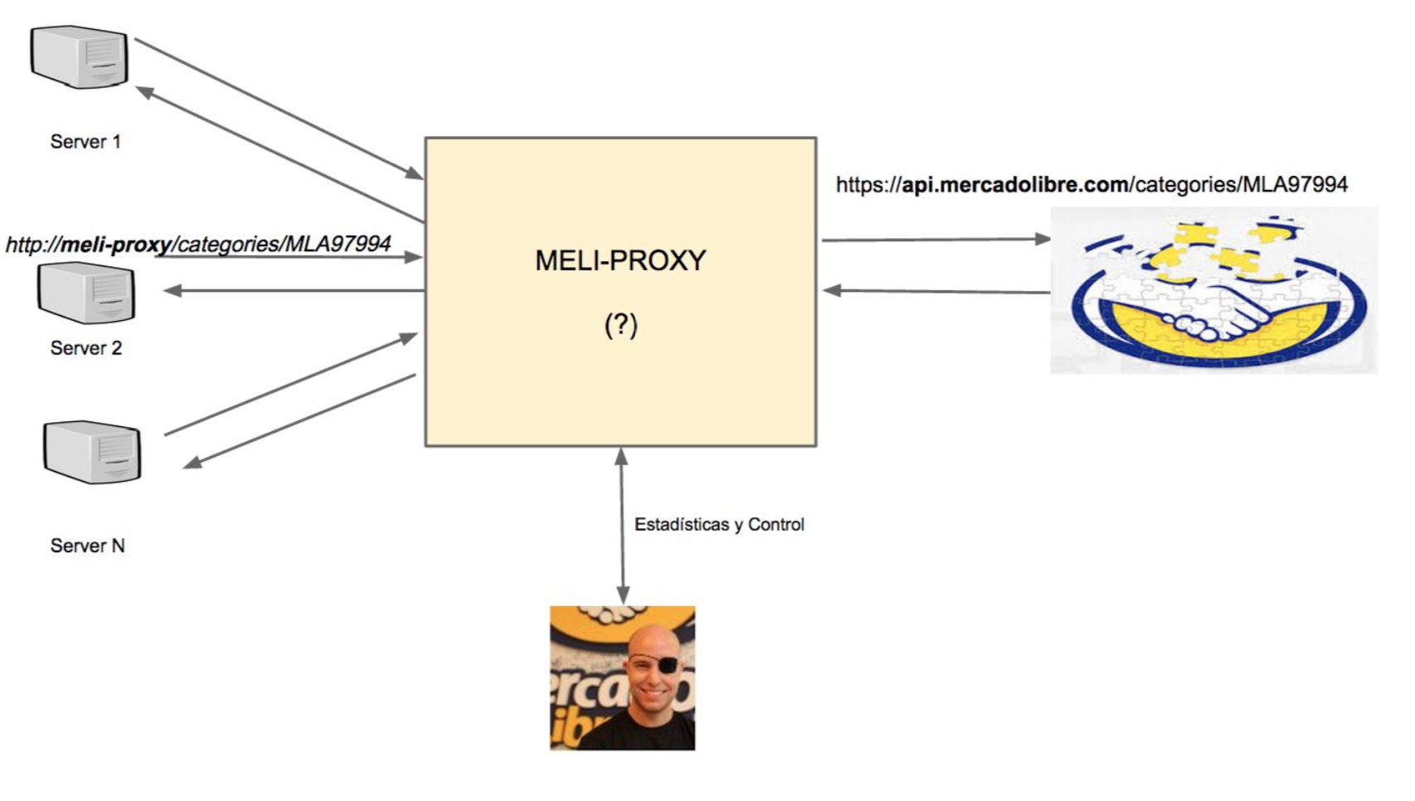
Problem

Slide 3
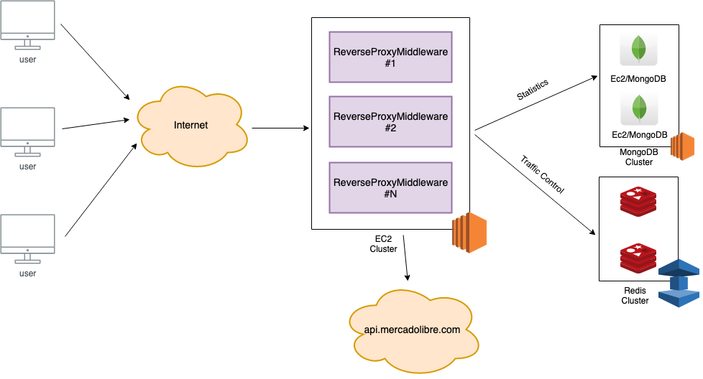
Solution

Slide 4
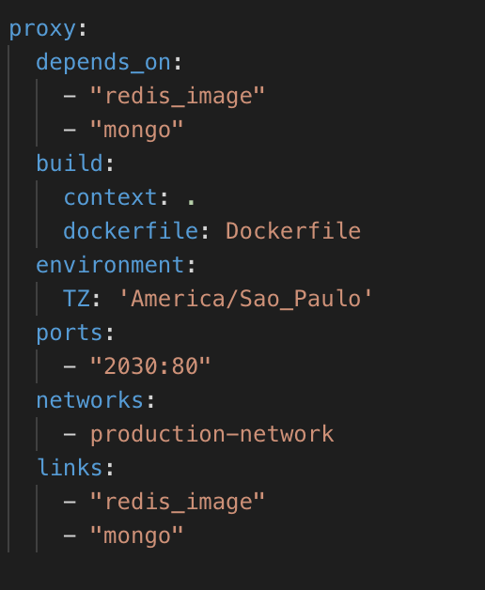
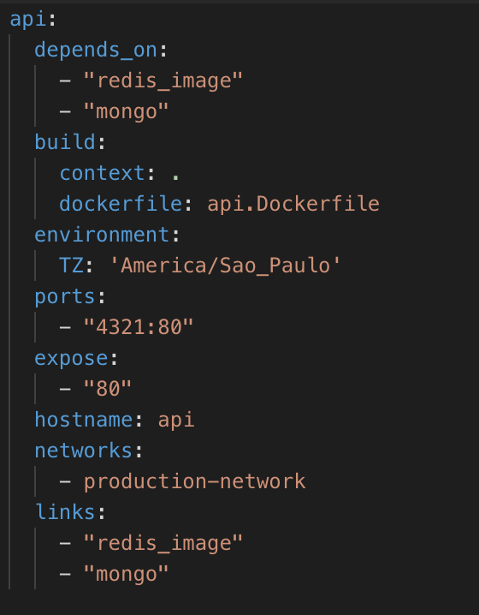
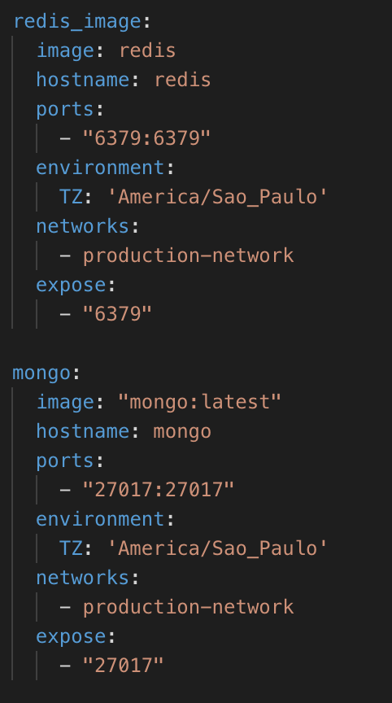
Docker-Compose

Slide 5
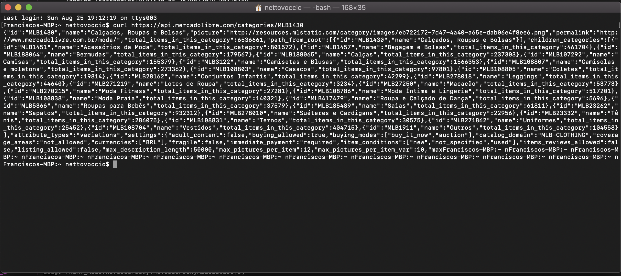
Curl test

Slide 6
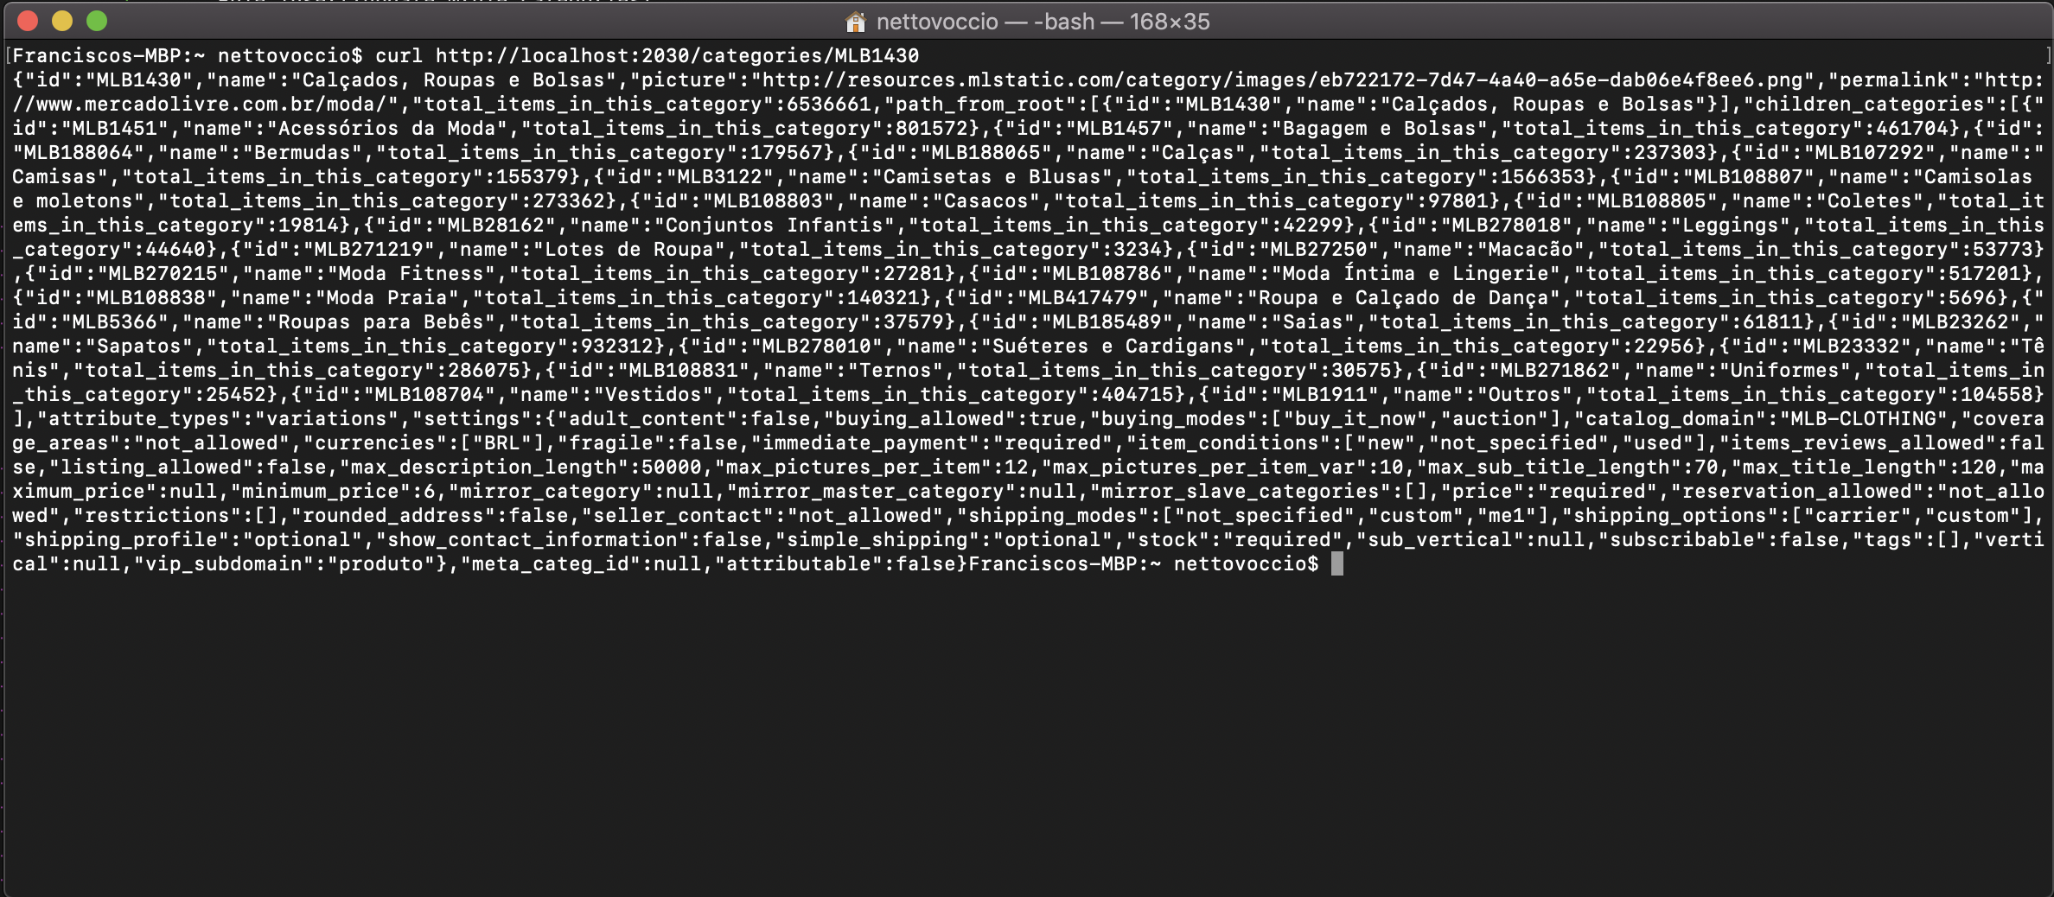
Curl test

Slide 7
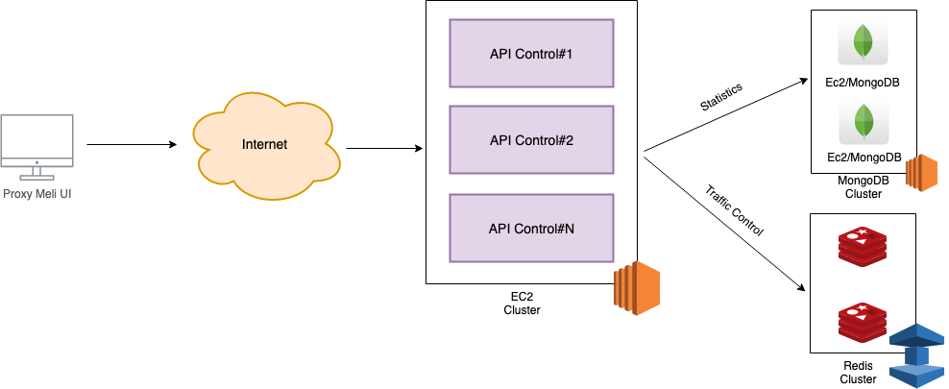
API Control

Slide 8
API Restfull
Verb | Path | Action | Used For
GET | api/v1/adminControl/id | GetAsync | Display a specific rule
POST | api/v1/adminControl | PostAsync | Create a new Rule
PUT | api/v1/adminControl/id | PutAsync | Update a Rule
DELETE | api/v1/adminControl/id | DeleteAsync | Delete a Rule
GET | api/v1/statistics/AllHits | GetAllRulesAsync | Display all hits per day
GET | api/v1/statistics/OKHits | GetOKHitsAsync | Display hits 200 per day
GET | api/v1/statistics/TooManyRequestsHits | GetTooManyRequestsHitsAsync | Display hits 429 per day
GET | api/v1/statistics/NotFoundRequestsHits | GetNotFoundRequestsHitsAsync | Display hits 404 per day
GET | api/v1/statistics/GetErrorsRequestsHitsAsync | ErrorsRequestsHits | Display hits 500 per day

Slide 9
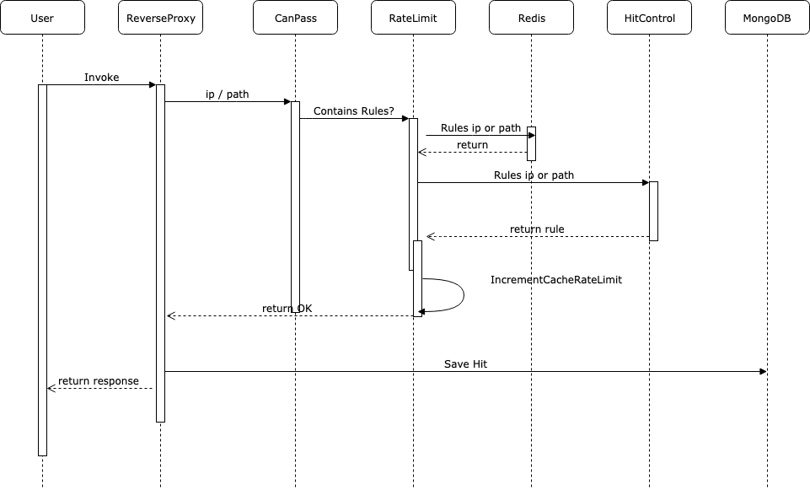
diagram sequence

Slide 10
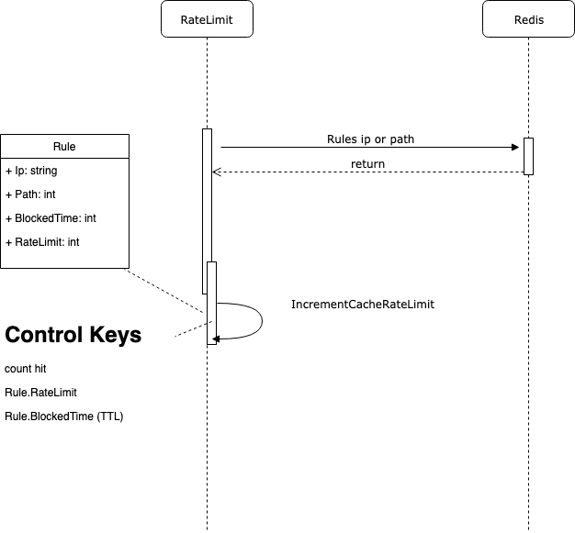
diagram sequence (Status code 429)

Slide 11
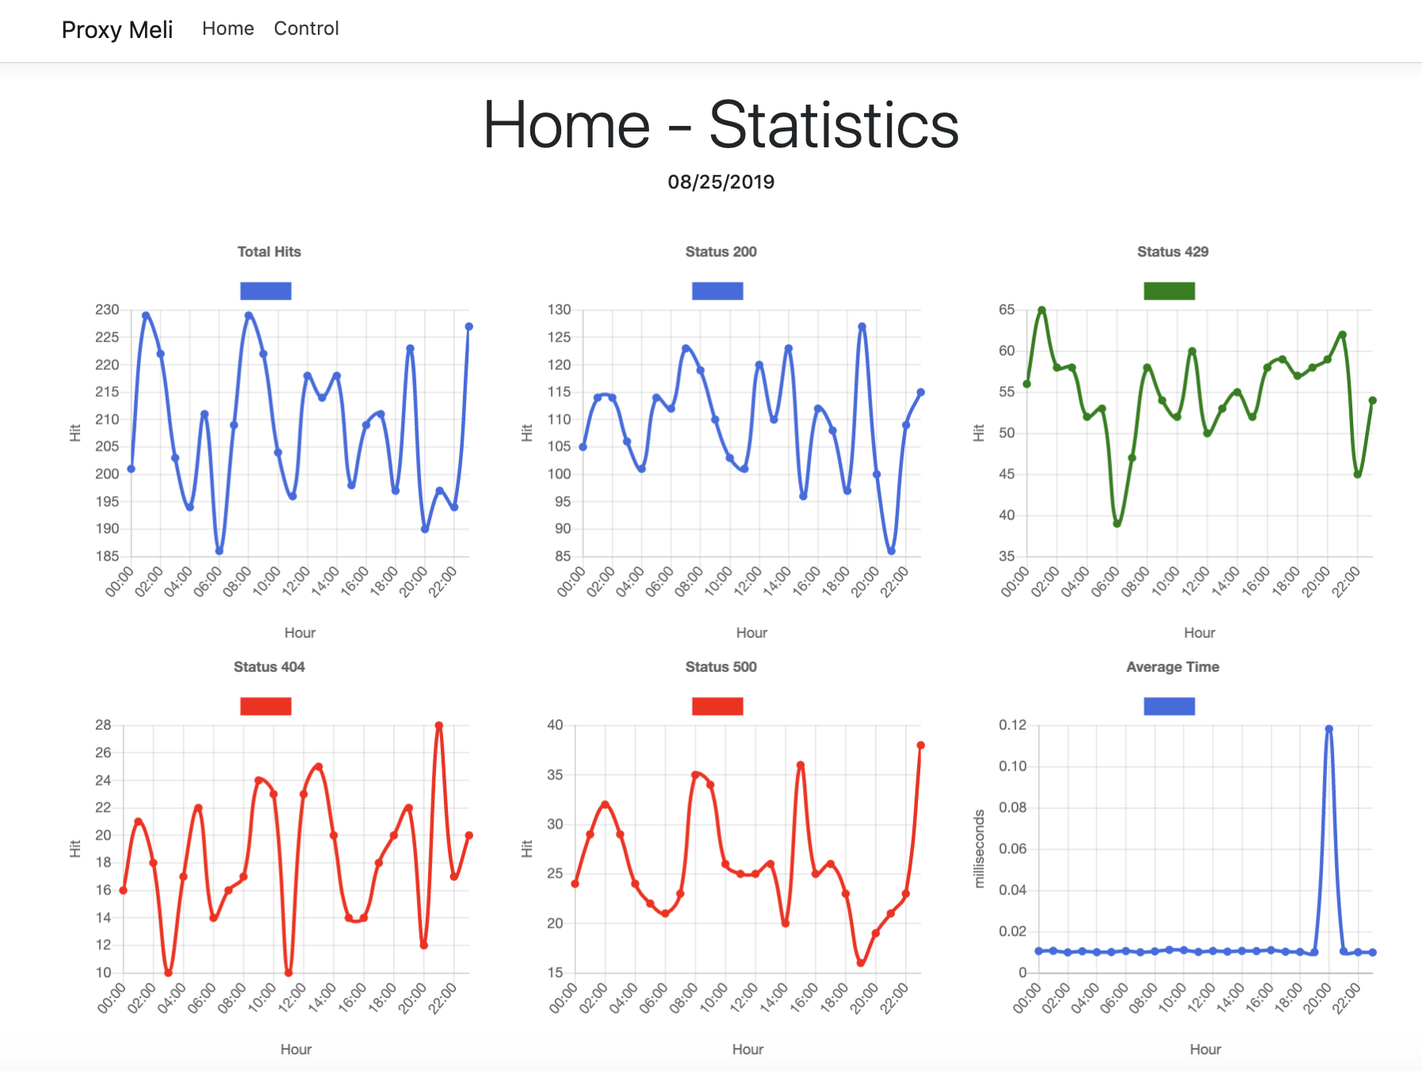
Proxy Meli UI - Statistics

Slide 12
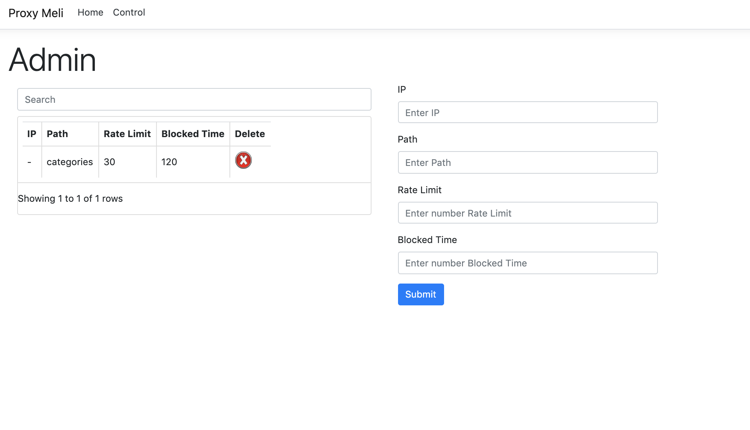
Proxy Meli UI - Control

Slide 13
Gracias ;)
https://github.com/voccionetto/meli-proxy/
Contactos: voccio@gmail.com

